Slide 1
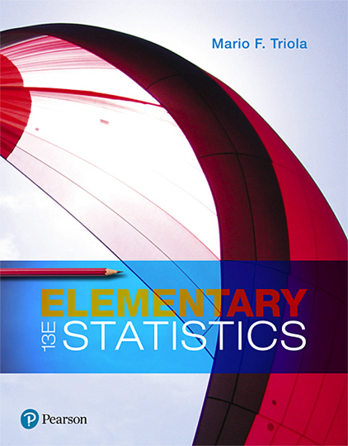
Elementary Statistics
Thirteenth Edition
Chapter 5
Probability Distributions
Copyright © 2018, 2014, 2012 Pearson Education, Inc. All Rights Reserved

Slide 2
Probability Distributions
5-1 Probability Distributions
5-2 Binomial Probability Distributions
5-3 Poisson Probability Distributions

Slide 3
Key Concept
The focus of this section is the binomial probability distribution and methods for finding probabilities.
Easy methods for finding the mean and standard deviation of a binomial distribution are also presented.
As in other sections, we stress the importance of interpreting probability values to determine whether events are significantly low or significantly high.

Slide 4
Binomial Probability Distribution (1 of 2)
Binomial Probability Distribution
A binomial probability distribution results from a procedure that meets these four requirements:
The procedure has a fixed number of trials. (A trial is a single observation.)
The trials must be independent, meaning that the outcome of any individual trial doesn’t affect the probabilities in the other trials.

Slide 5
Binomial Probability Distribution (2 of 2)
Binomial Probability Distribution
A binomial probability distribution results from a procedure that meets these four requirements:
Each trial must have all outcomes classified into exactly two categories, commonly referred to as success and failure.
The probability of a success remains the same in all trials.

Slide 6
Notation for Binomial Probability Distributions (1 of 3)
S and F (success and failure) denote the two possible categories of all outcomes.
P(S) = p(p = probability of a success)
P(F) = 1 − p = q(q = probability of a failure)
n the fixed number of trials

Slide 7
Notation for Binomial Probability Distributions (2 of 3)
x - a specific number of successes in n trials, so x can be any whole number between 0 and n, inclusive
p - probability of success in one of the n trials
q - probability of failure in one of the n trials
P(x) - probability of getting exactly x successes among the n trials

Slide 8
Notation for Binomial Probability Distributions (3 of 3)
The word success as used here is arbitrary and does not necessarily represent something good. Either of the two possible categories may be called the success S as long as its probability is identified as p.
CAUTION When using a binomial probability distribution, always be sure that x and p are consistent in the sense that they both refer to the same category being called a success.

Slide 9
Example: Twitter (1 of 8)
When an adult is randomly selected (with replacement), there is a 0.85 probability that this person knows what Twitter is (based on results from a Pew Research Center survey). Suppose that we want to find the probability that exactly three of five randomly selected adults know what Twitter is.
a. Does this procedure result in a binomial distribution?
b. If this procedure does result in a binomial distribution, identify the values of n, x, p, and q.

Slide 10
Example: Twitter (2 of 8)
Solution
a. This procedure does satisfy the requirements for a binomial distribution, as shown below.
The number of trials (5) is fixed.
The 5 trials are independent because the probability of any adult knowing Twitter is not affected by results from other selected adults.

Slide 11
Example: Twitter (3 of 8)
Solution
Each of the 5 trials has two categories of outcomes: The selected person knows what Twitter is or that person does not know what Twitter is.
For each randomly selected adult, there is a 0.85 probability that this person knows what Twitter is, and that probability remains the same for each of the five selected people.

Slide 12
Example: Twitter (4 of 8)
Solution
b. Having concluded that the given procedure does result in a binomial distribution, we now proceed to identify the values of n, x, p, and q.
With five randomly selected adults, we have n = 5.
We want the probability of exactly three who know what Twitter is, so x = 3.

Slide 13
Example: Twitter (5 of 8)
Solution
The probability of success (getting a person who knows what Twitter is) for one selection is 0.85, so p = 0.85.
The probability of failure (not getting someone who knows what Twitter is) is 0.15, so q = 0.15.

Slide 14
Example: Twitter (6 of 8)
Solution
Again, it is very important to be sure that x and p both refer to the same concept of “success.” In this example, we use x to count the number of people who know what Twitter is, so p must be the probability that the selected person knows what Twitter is. Therefore, x and p do use the same concept of success: knowing what Twitter is.

Slide 15

Methods for Finding Binomial Probabilities (1 of 4)
Method 1: Binomial Probability Formula
where
n = number of trials
x = number of successes among n trials
p = probability of success in any one trial
q = probability of failure in any one trial (q = 1 − p)

Slide 16
Example: Twitter (7 of 8)
Given that there is a 0.85 probability that a randomly selected adult knows what Twitter is, use the binomial probability formula to find the probability that when five adults are randomly selected, exactly three of them know what Twitter is. That is, apply the previous formula to find P(3) given that n = 5, x = 3, p = 0.85, and q = 0.15.

Slide 17
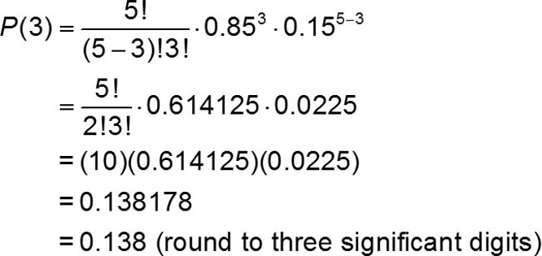
Example: Twitter (8 of 8)
Solution
Using the given values of n, x, p, and q in the binomial probability formula, we get
The probability of getting exactly three adults who know Twitter among five randomly selected adults is 0.138.

Slide 18
Methods for Finding Binomial Probabilities (2 of 4)
Method 2: Using Technology
Technologies can be used to find binomial probabilities. The screen displays on the next slide list binomial probabilities for n = 5 and p = 0.85, as in the previous example. Notice that in each display, the probability distribution is given as a table.

Slide 19
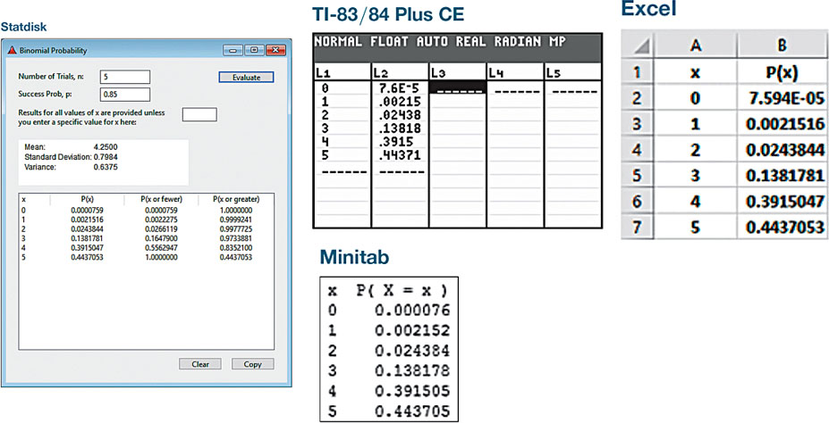
Methods for Finding Binomial Probabilities (3 of 4)
Method 2: Using Technology

Slide 20
Example: Overtime Rule in Football (1 of 4)
We previously noted that between 1974 and 2011, there were 460 NFL football games decided in overtime, and 252 of them were won by the team that won the overtime coin toss. Is the result of 252 wins in the 460 games equivalent to random chance, or is 252 wins significantly high? We can answer that question by finding the probability of 252 wins or more in 460 games, assuming that wins and losses are equally likely.

Slide 21
Example: Overtime Rule in Football (2 of 4)
Solution
Using the notation for binomial probabilities, we have n = 460, p = 0.5, q = 0.5, and we want to find the sum of all probabilities for each value of x from 252 through 460. The formula is not practical here, because we would need to apply it 209 times—we don’t want to go there. Table A-1 (Binomial Probabilities) doesn’t apply because n = 460, which is way beyond the scope of that table. Instead, we wisely choose to use technology.

Slide 22
Example: Overtime Rule in Football (3 of 4)
Solution
The Statdisk display on the next page shows that the probability of 252 or more wins in 460 overtime games is 0.0224 (rounded), which is low (such as less than 0.05). This shows that it is unlikely that we would get 252 or more wins by chance. If we effectively rule out chance, we are left with the more reasonable explanation that the team winning the overtime coin toss has a better chance of winning the game.

Slide 23
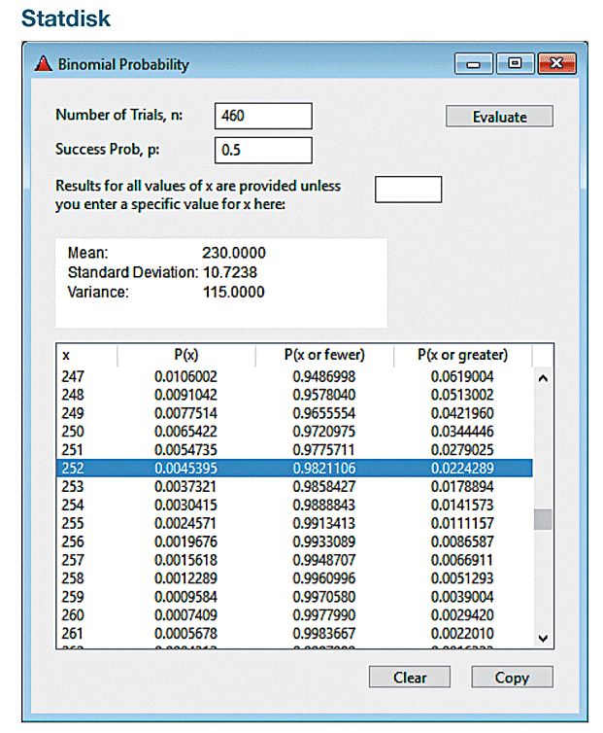
Example: Overtime Rule in Football (4 of 4)
Solution

Slide 24
Methods for Finding Binomial Probabilities (4 of 4)
Method 3: Using Table A-1 in Appendix A
This method can be skipped if technology is available. Table A-1 in Appendix A lists binomial probabilities for select values of n and p. It cannot be used if n > 8 or if the probability p is not one of the 13 values included in the table.
To use the table of binomial probabilities, we must first locate n and the desired corresponding value of x. At this stage, one row of numbers should be isolated. Now align that row with the desired probability of p by using the column across the top. The isolated number represents the desired probability. A very small probability, such as 0.000064, is indicated by 0+.

Slide 25
Example: Devil of a Problem (1 of 3)
Based on a Harris poll, 60% of adults believe in the devil. Assuming that we randomly select five adults, use Table A-1 to find the following:
a. The probability that exactly three of the five adults believe in the devil
b. The probability that the number of adults who believe in the devil is at least two

Slide 26
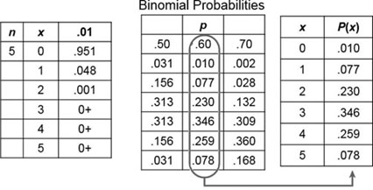
Example: Devil of a Problem (2 of 3)
Solution
a. The following excerpt from the table shows that when n = 5 and p = 0.6, the probability for x = 3 is given by P(3) = 0.346.
TABLE A-1

Slide 27
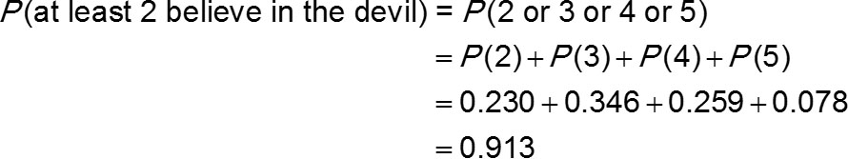
Example: Devil of a Problem (3 of 3)
Solution
b. The phrase “at least two” successes means that the number of successes is 2 or 3 or 4 or 5.

Slide 28
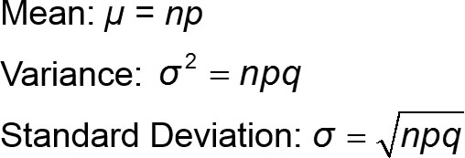
Using Mean and Standard Deviation for Critical Thinking
For Binomial Distributions

Slide 29
Range Rule of Thumb
Significantly low values ≤ (µ − 2σ)
Significantly high values ≥ (µ + 2σ)
Values not significant: Between (µ − 2σ) and (µ + 2σ)

Slide 30
Example: Using Parameters to Determine Significance (1 of 4)
A previous example involved n = 460 overtime wins in NFL football games. We get p = 0.5 and q = 0.5 by assuming that winning the overtime coin toss does not provide an advantage, so both teams have the same 0.5 chance of winning the game in overtime.
a. Find the mean and standard deviation for the number of wins in groups of 460 games.
b. Use the range rule of thumb to find the values separating the numbers of wins that are significantly low or significantly high.
c. Is the result of 252 overtime wins in 460 games significantly high?

Slide 31
Example: Using Parameters to Determine Significance (2 of 4)
Solution
a. With n = 460, p = 0.5, and q = 0.5, previous formulas can be applied as follows:
µ = np = (460)(0.5) = 230.0 games
For random groups of 460 overtime games, the mean number of wins is 230.0 games, and the standard deviation is 10.7 games.

Slide 32
Example: Using Parameters to Determine Significance (3 of 4)
Solution
b. The values separating numbers of wins that are significantly low or significantly high are the values that are two standard deviations away from the mean. With µ = 230.0 games and σ = 10.7 games, we get
(µ − 2σ) = 230.0 − 2(10.7) = 208.6 games
(µ + 2σ) = 230.0 + 2(10.7) = 251.4 games

Slide 33
Example: Using Parameters to Determine Significance (4 of 4)
Solution
Significantly low numbers of wins are 208.6 games or fewer, significantly high numbers of wins are 251.4 games or greater, and values not significant are between 208.6 games and 251.4 games.
c. The result of 252 wins is significantly high because it is greater than the value of 251.4 games found in part (b).

Slide 34
Using Probabilities to Determine When Results Are Significantly High or Low
Significantly high number of successes:
x successes among n trials is significantly high if the probability of x or more successes is 0.05 or less. That is, x is a significantly high number of successes if P(x or more) ≤ 0.05.
Significantly low number of successes:
x successes among n trials is significantly low if the probability of x or fewer successes is 0.05 or less. That is, x is a significantly low number of successes if P(x or fewer) ≤ 0.05.

Slide 35
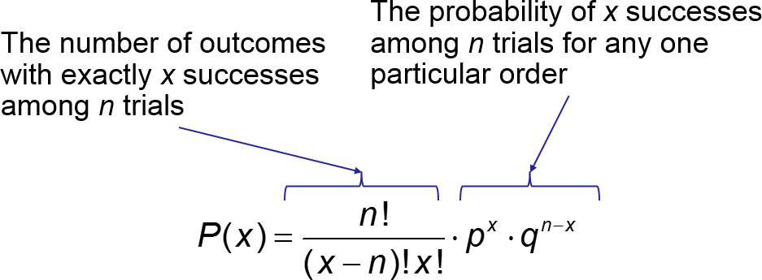
Rationale for the Binomial Probability Formula

